Slide 1

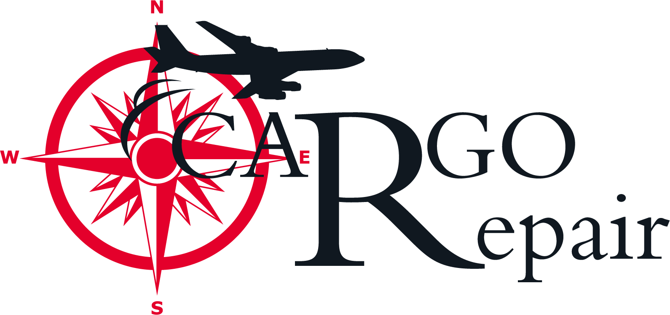



Reducing Costs with FCAH Aerospace
DER Capabilities

Slide 2

AGENDA
Introducing our Speaker
A brief overview of FCAH Aerospace
A deep dive into AVI Aviation Inflatables DER Major Repairs
An introduction to Cargo Repair’s new DER Capabilities for Collins Caster Panels
Questions/Closing Statement
Christopher Cartwright
Engineering Manager

Slide 3
Our About FCAH Aerospace
About FCAH Aerospace
FCAH Aerospace includes a family of brands that collectively provide comprehensive aftermarket aviation solutions, focused on delivering high-quality OEM, PMA, and aftermarket parts, maintenance, repair, overhaul, storage, disassembly, emergency equipment, and customer service with care and urgency.
Our brands include Air Cargo Equipment, AVI Aviation and its divisions, Cargo Repair, Cobalt Aero Services, and First Class Air Support.
Total Square Footage
Over 434,000 square feet of warehouse space
Locations
10 locations and 15 distribution centers
Customers
Supporting over 750 Customers
Solutions
  Offering Specialized repair solutions for cargo loading systems and components
  Providing More than 2M Parts including PMA
  Reducing cost by up to 60% with DER Capabilities
  Specializes in maintaining, repairing, and overhauling of large components
  Manufacturing Compact Lightweight Survival Rafts for aviation Industry
  Supporting your End of Life with Teardown capabilities
Visit our website to learn more
https://fcahaerospace.com

Slide 4
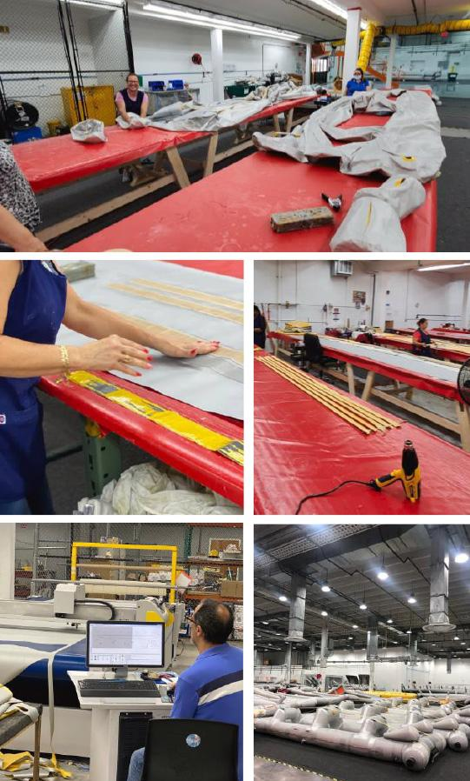

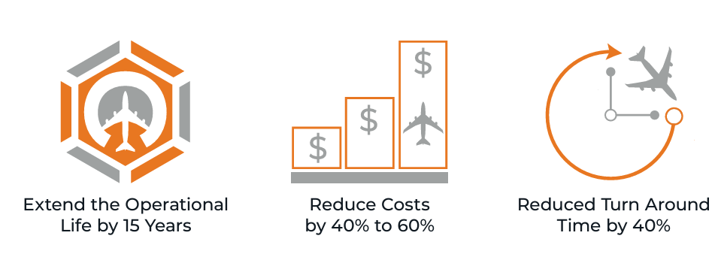
Aviation Inflatables DER Major Repairs
What are the Benefits to our AVI Aviation Inflatable’s Major Repairs?

Slide 5
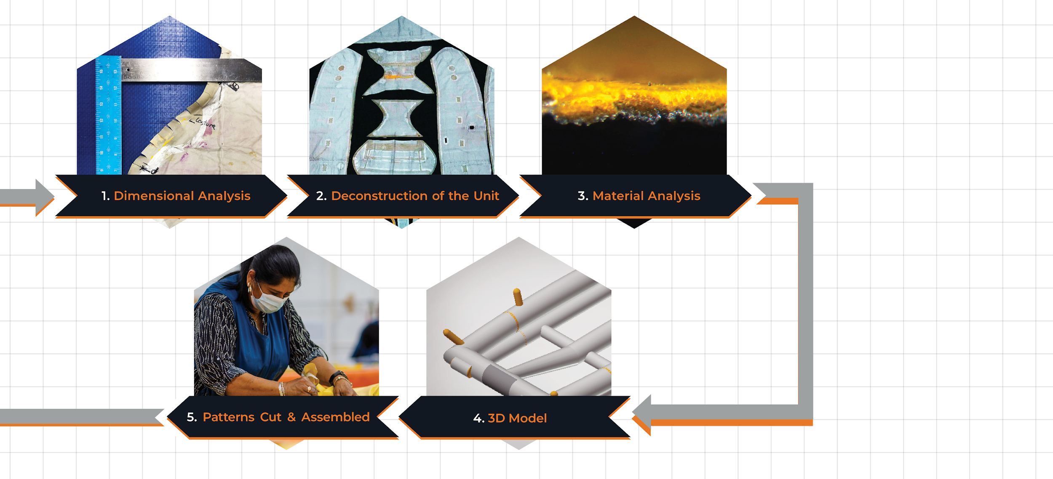
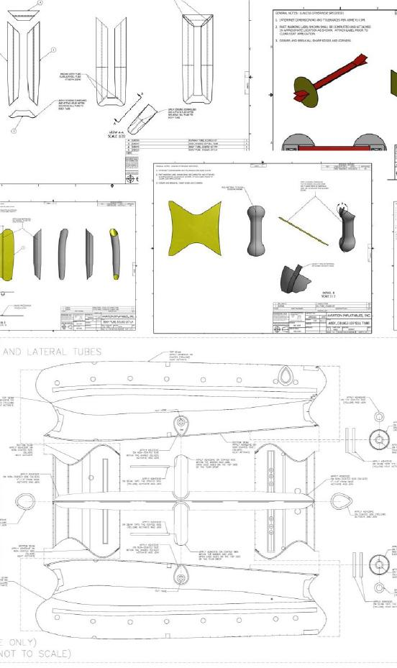
The Development Process

Slide 6
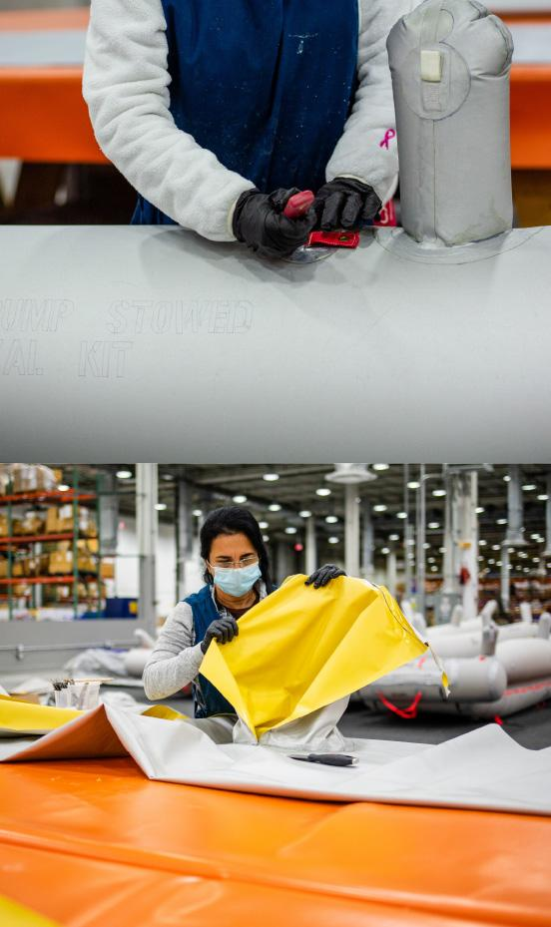
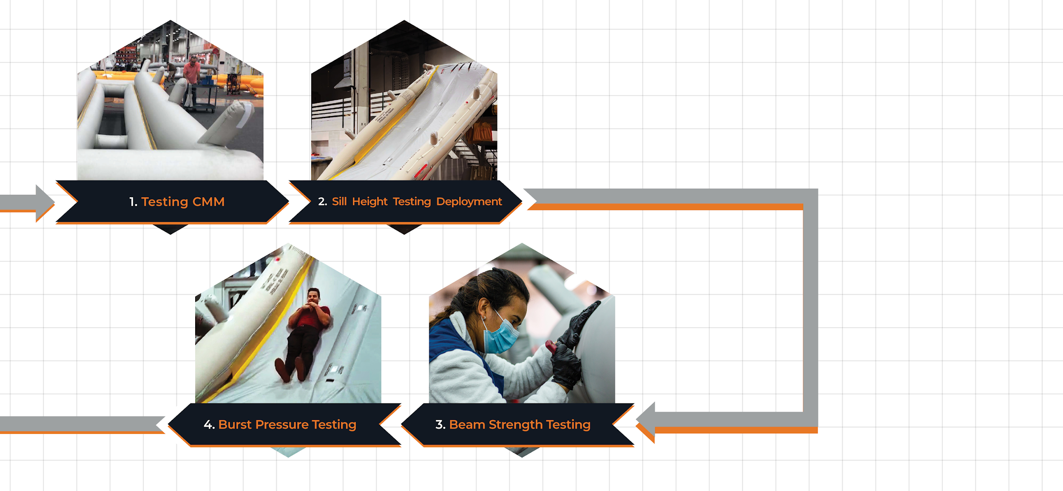
The Validation Process

Slide 7
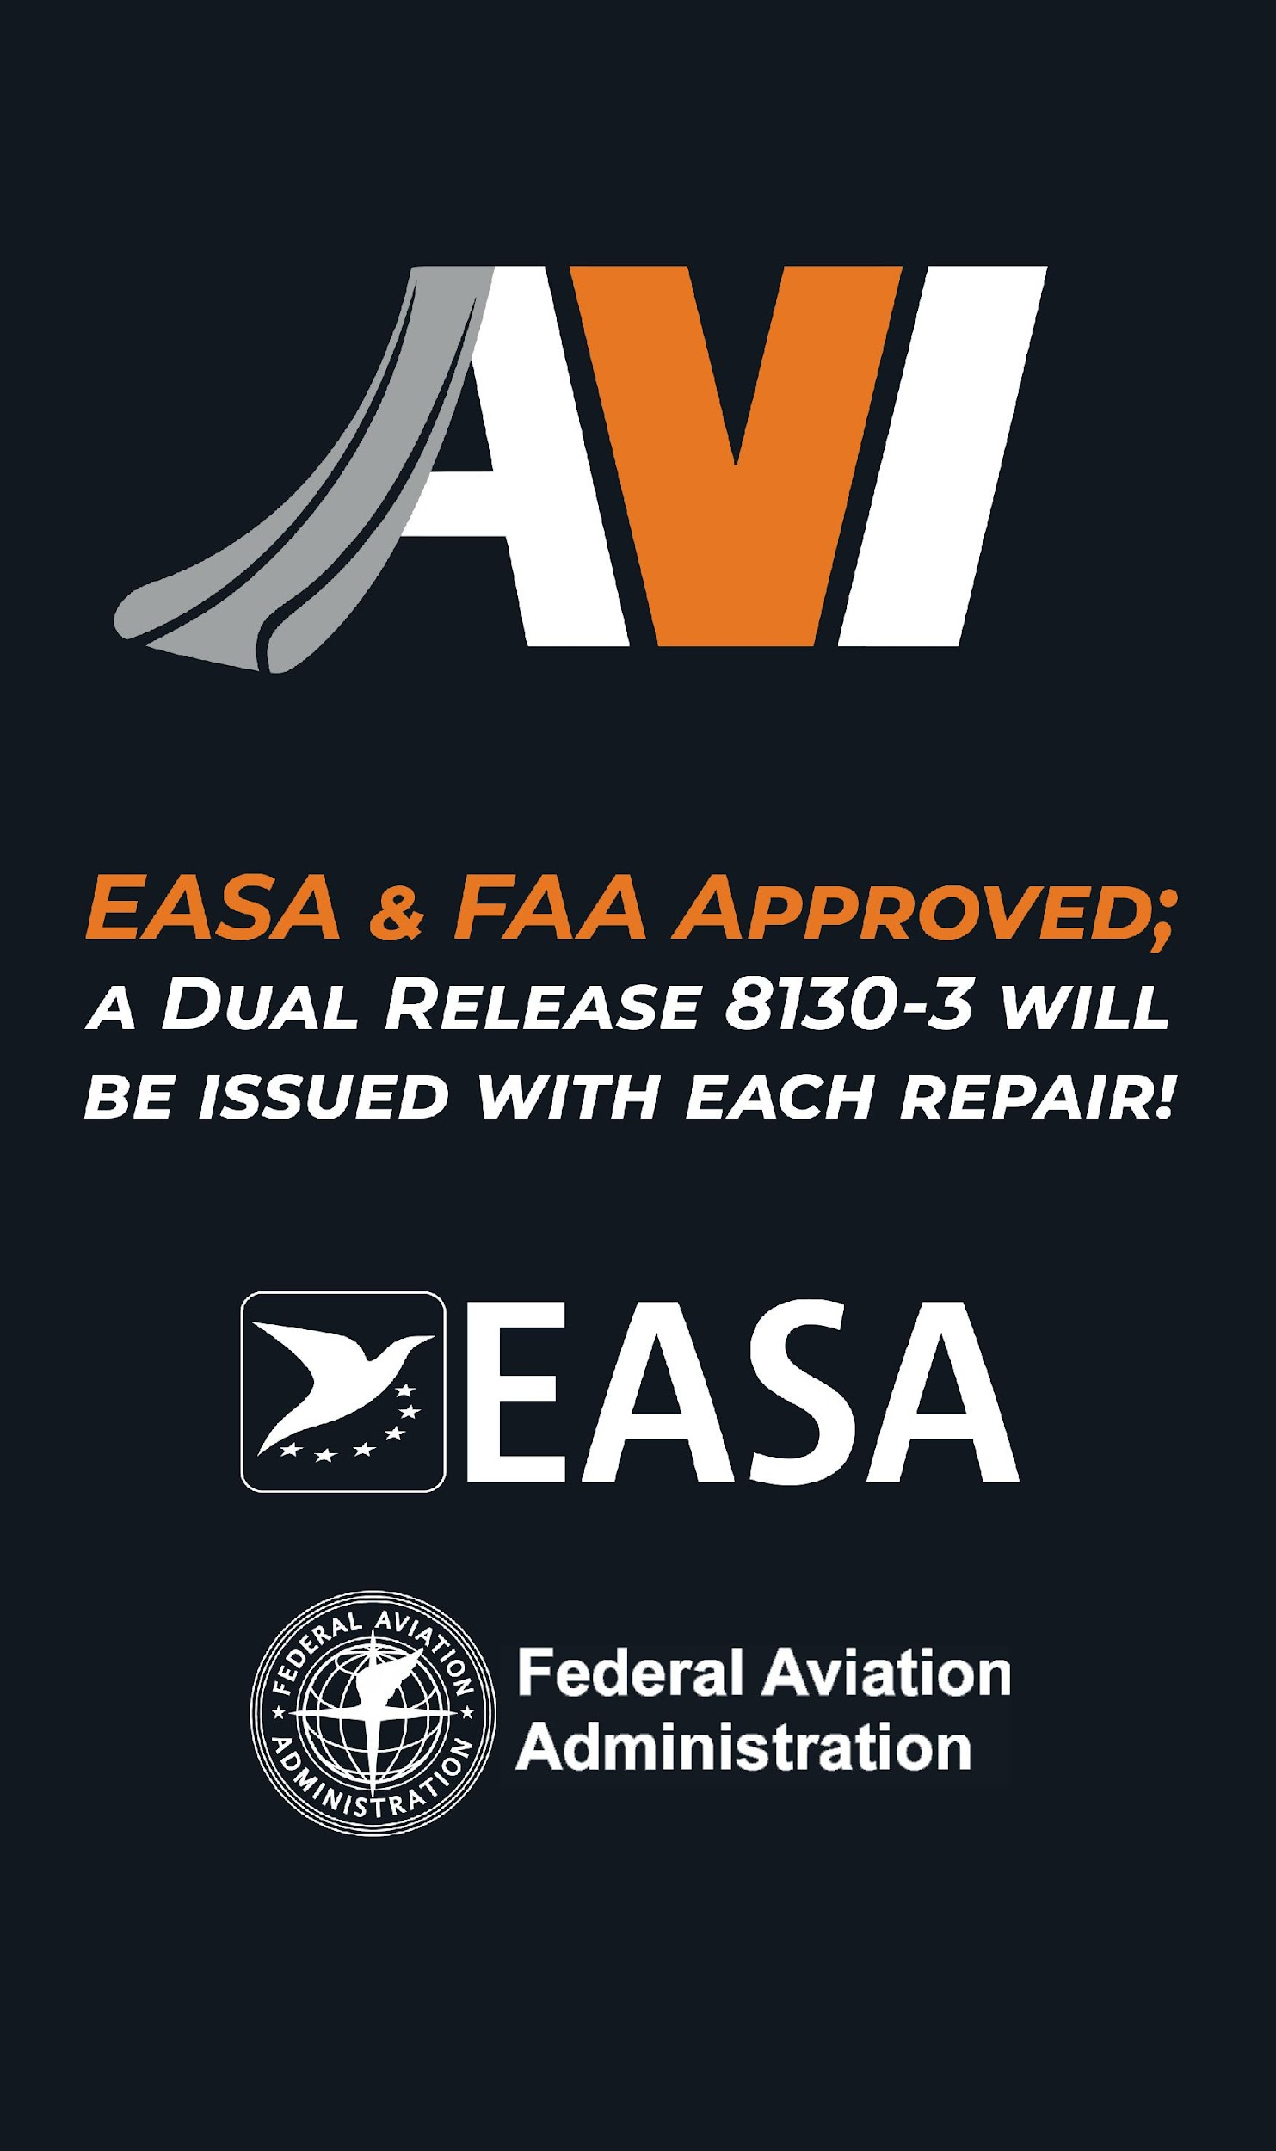
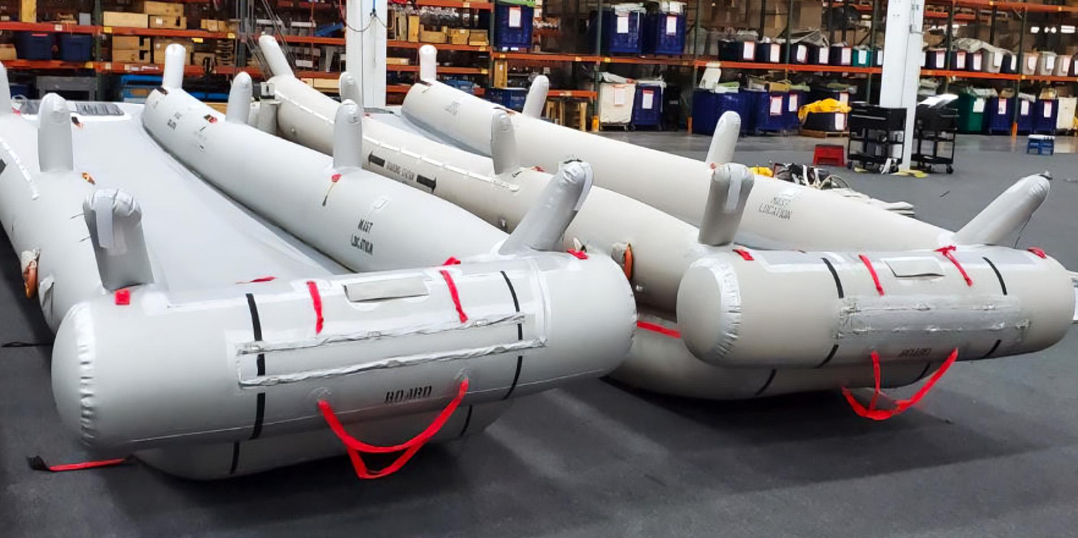
Delivering on Quality
Assembly Techniques
Inspection Points
Assembly Tools
Same Testing Requirements
Same Quality of Work
Slide-by-Slide
Comparison
OEM
AVI

Slide 8
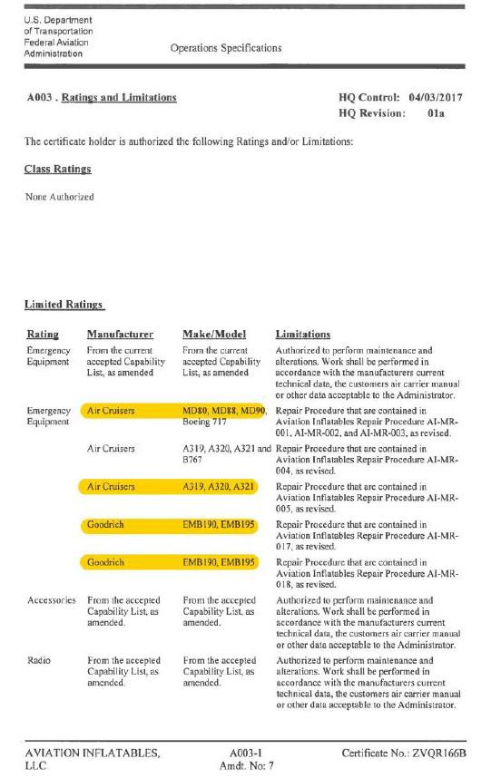
Current Repairs
AVI Aviation Inflatables offers DER Major Repairs for:
MD80, MD88, 717 - FWD, REAR, TAILCONE DOORS
A319, A320, A321 - FWD & AFT DOOR
MD 11 - DOOR 1
737 - FWD & AFT DOOR
DC8 - FWD & AFT DOOR
757 - DOOR 1 • E190 - FWD & AFT
A319, A320, A321 – OFF-WING
747 SUD EMERGENCY EXIT DOOR

Slide 9
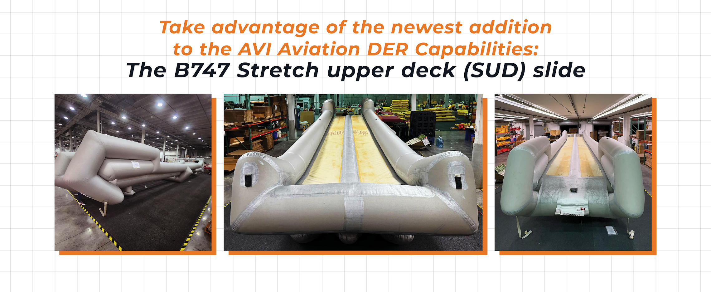
Newest Repair Capabilities

Slide 10
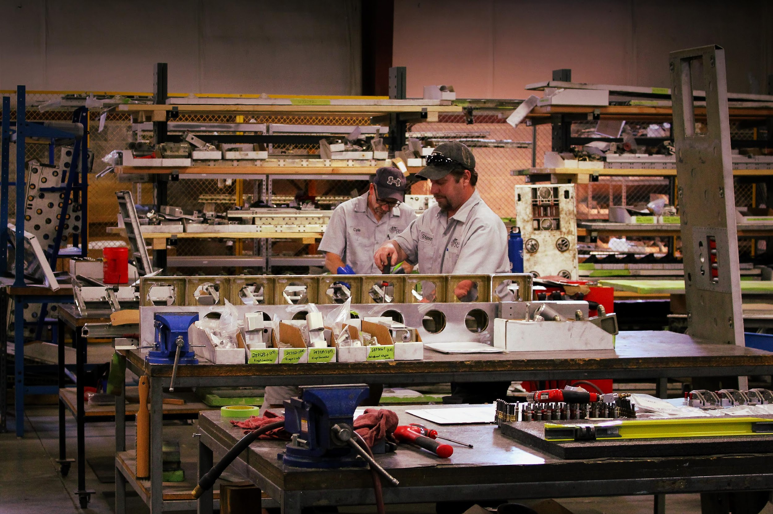


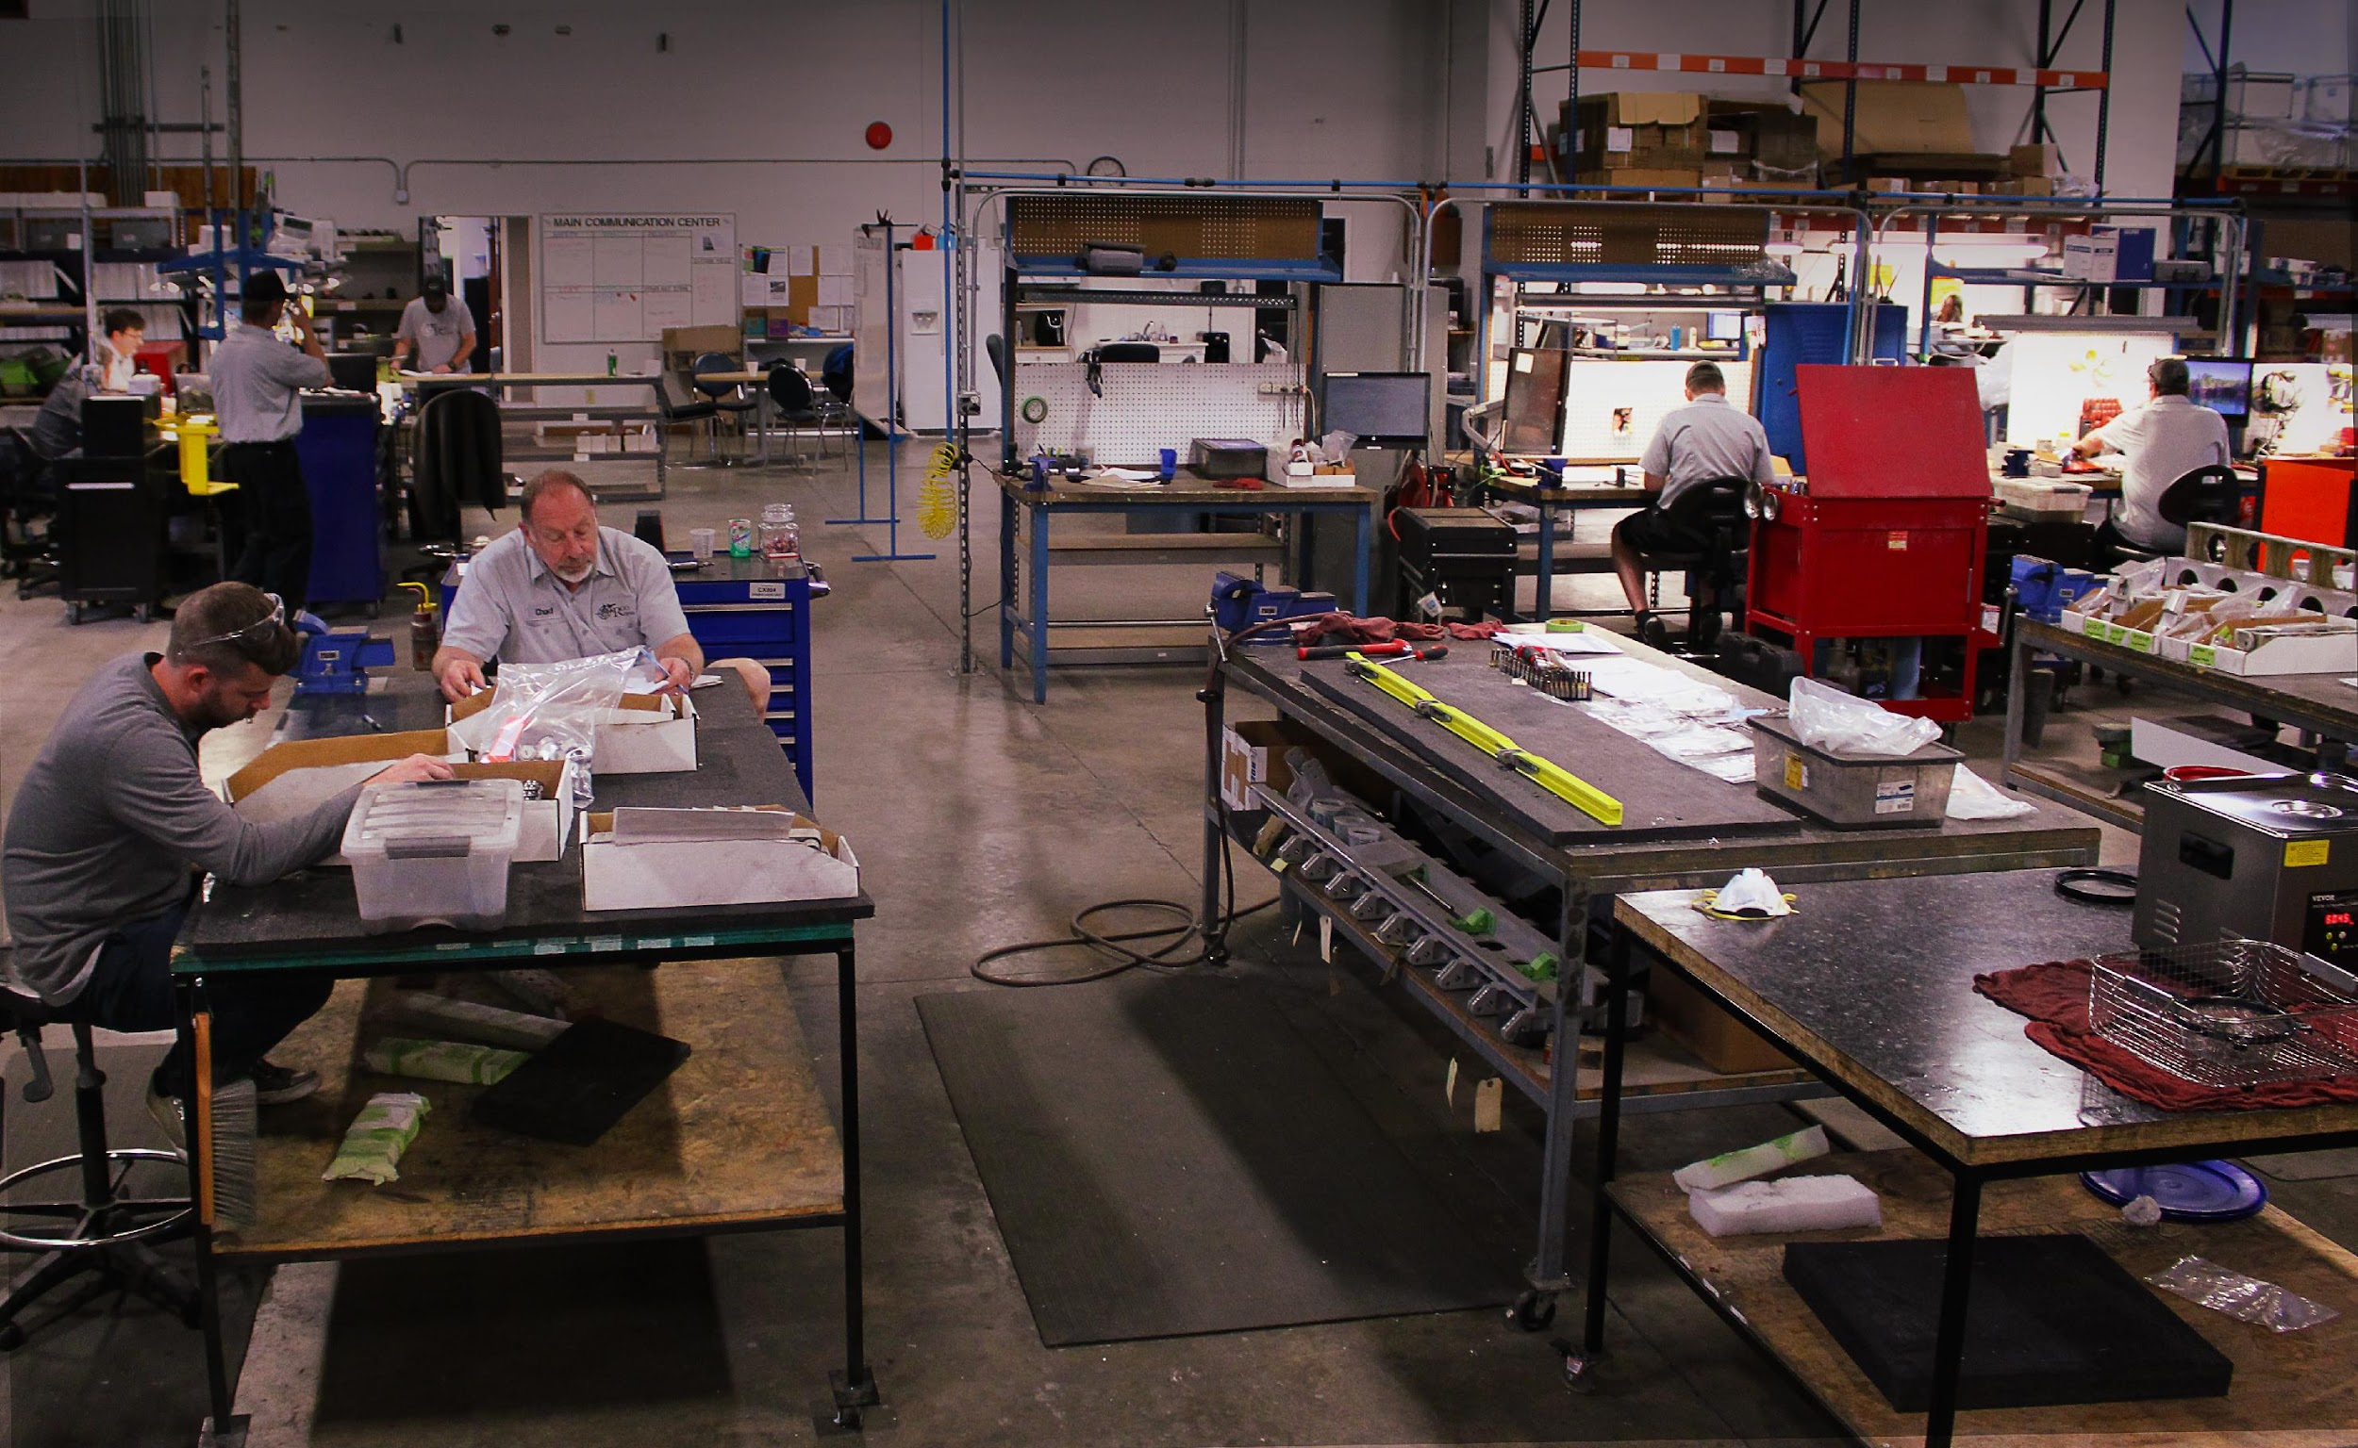
Cargo Repair DER for Collins Caster Panels
What are the benefits of Cargo Repair
DER capability for Collins Casters panels?
Cost-Saving
Reduced Lead Time

Slide 11
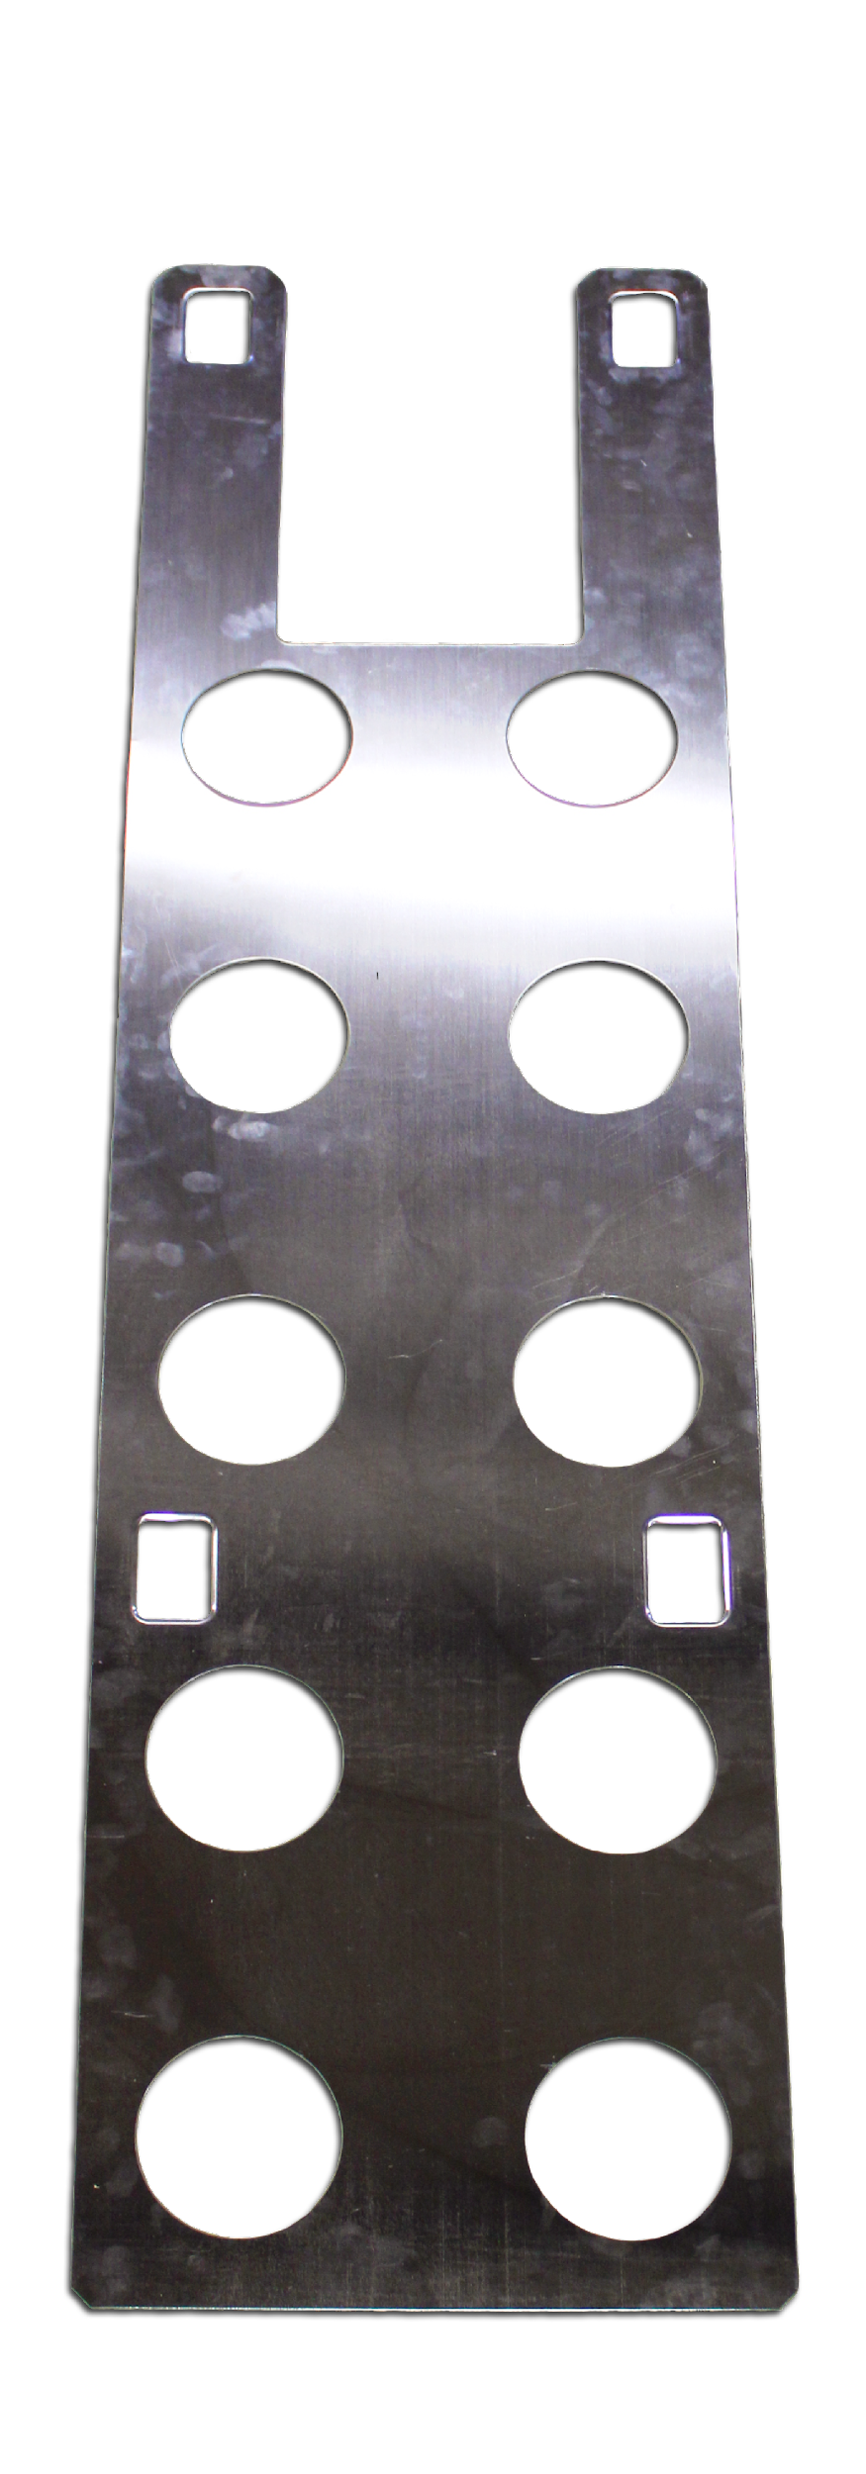
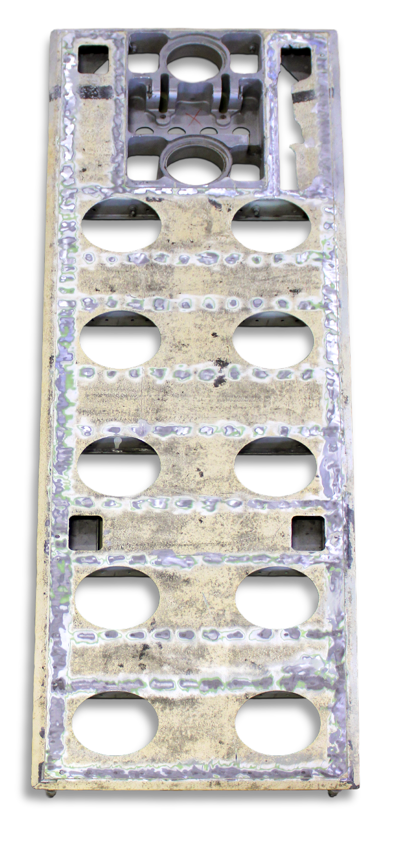
Before and After DER
BEFORE
Damaged panels had to be completely discarded because the original manufacturer no longer supplied repair parts.
New assemblies required long lead times from the OEM
But now, with our DER repair option, you have an economical and cost-saving solution for these panels that were once considered beyond economical repair (BER).
AFTER
With our DER repair option, you have an economical and cost-saving solution for these panels that were once considered beyond economical repair (BER).
You can have your assembly repaired at a fraction of the cost and receive it in just a few weeks, saving you both time and money.

Slide 12
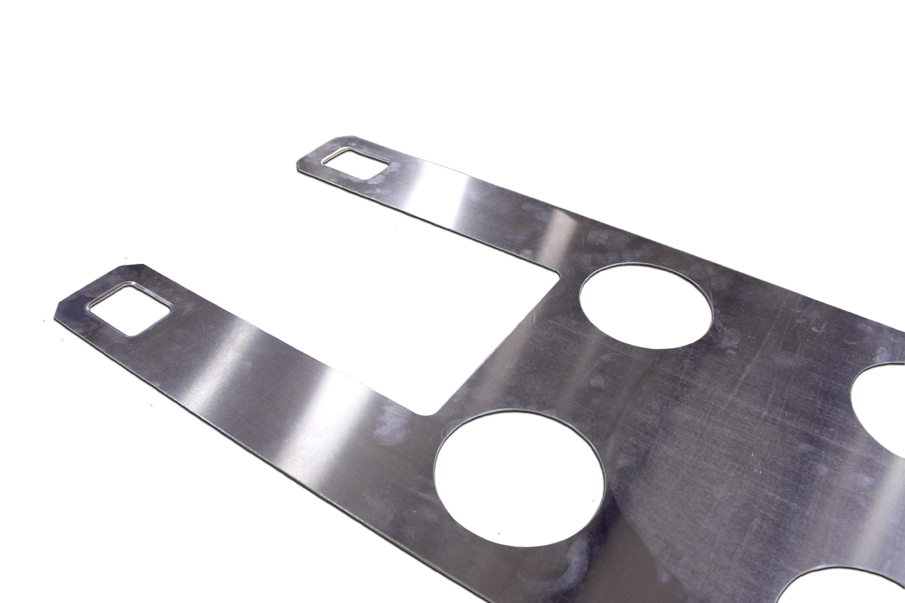
Current Repairs
Cargo Repair offers DER Repairs for the following part numbers:
7M1650-1
        7M1652-1
7M1653-1
7M1654-1
7M1655-1
7M1656-1
7M1659-1

Slide 13
Thank You!
Questions?

