Slide 1






Gaining a Competitive Edge with our Trailblazing
Innovative Products

Slide 2

AGENDA
Introducing our Speaker
A brief overview of FCAH Aerospace
Overview of our New 65 Passenger Rafts
Overview of our 6 Passenger Rafts
Questions/Closing Statement
Christopher Cartwright
Engineering Manager

Slide 3
Our About FCAH Aerospace
About FCAH Aerospace
FCAH Aerospace includes a family of brands that collectively provide comprehensive aftermarket aviation solutions, focused on delivering high-quality OEM, PMA, and aftermarket parts, maintenance, repair, overhaul, storage, disassembly, emergency equipment, and customer service with care and urgency.
Our brands include Air Cargo Equipment, AVI Aviation and its divisions, Cargo Repair, Cobalt Aero Services, and First Class Air Support.
Total Square Footage
Over 434,000 square feet of warehouse space
Locations
10 locations and 15 distribution centers
Customers
Supporting over 750 Customers
Solutions
  Offering Specialized repair solutions for cargo loading systems and components
  Providing More than 2M Parts including PMA
  Reducing cost by up to 60% with DER Capabilities
  Specializes in maintaining, repairing, and overhauling of large components
  Manufacturing Compact Lightweight Survival Rafts for aviation Industry
  Supporting your End of Life with Teardown capabilities
Visit our website to learn more
https://fcahaerospace.com

Slide 4



Innovation that Delivers
At FCAH Aerospace, we believe in creating innovative products that will give you a competitive edge. This includes the first-ever 65-passenger raft from AVI Aviation. This new 65-passenger raft will be the game changer for your fleet. In addition, we also have the 6-passenger reversible life raft that can support your survival product requirements.
TOP QUALITY
COST SAVINGS
REDUCED INVENTORY NEEDS

Slide 5

65 – Passenger Raft – Pre-order Today
65 Passenger Raft
AVI Aviation’s 65-passenger raft is the first in the industry! And with our new raft, you can expect the same exceptional quality of product that is synonymous with Avi Aviation, in additional to cost savings!
Features
No Additional Configuration Needed
Reduces Inventory Requirements
Extended Repair Cycle of 3 years to 5 years

Slide 6
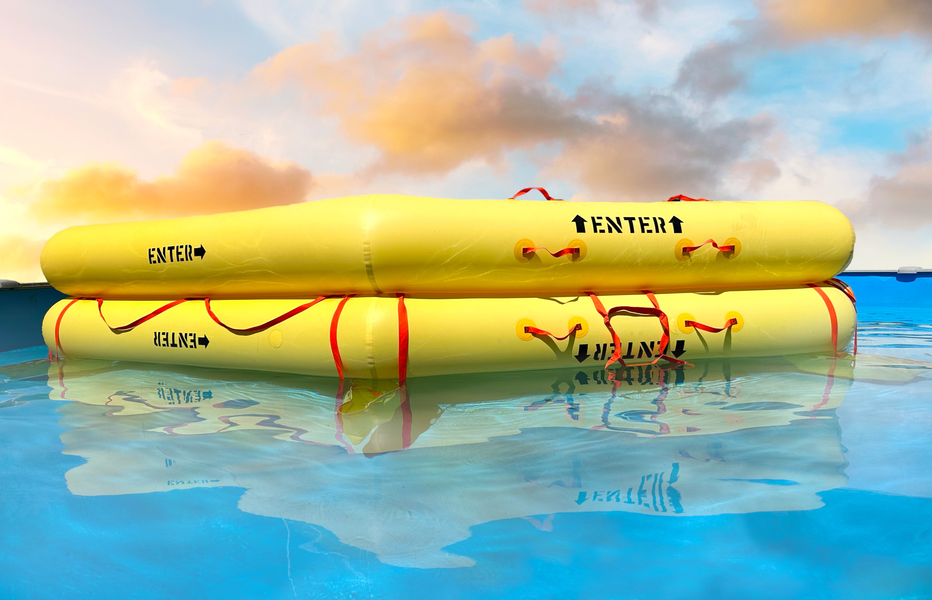

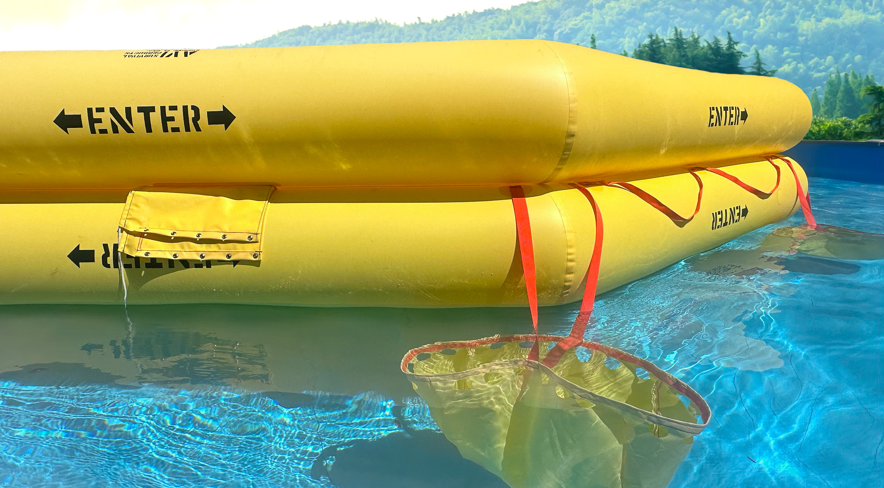
65 – Passenger Raft – Pre-order Today

Slide 7
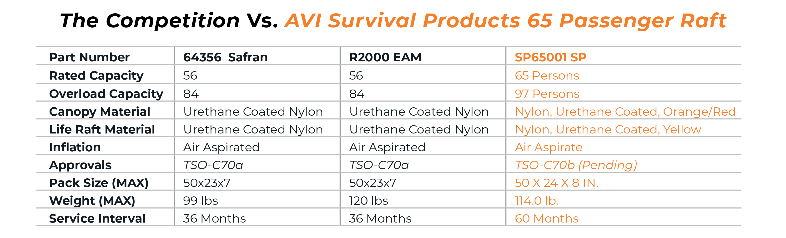
56 versus 65 Passenger Raft

Slide 8
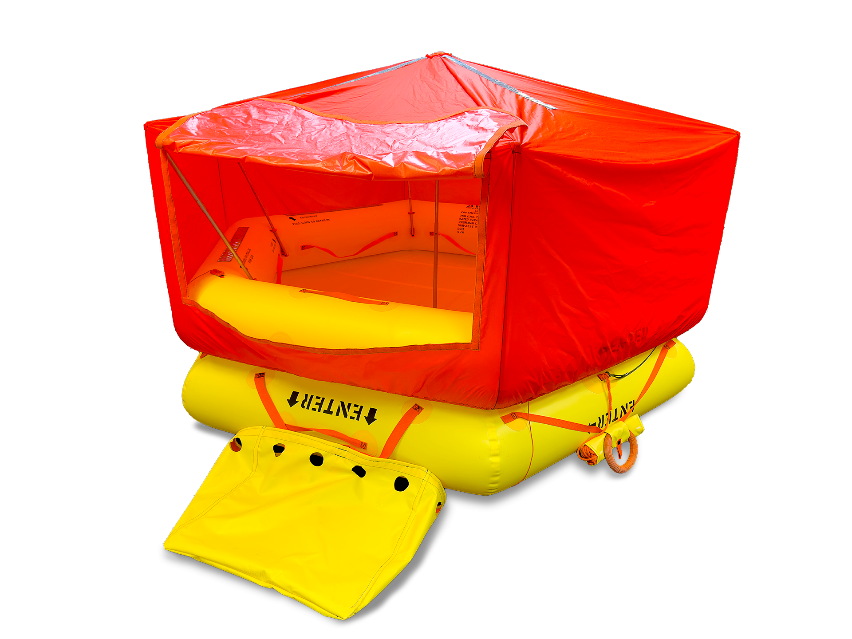
AVI Aviation’s 6 – Passenger Reversible Raft
6 – Passenger Reversible Life Raft
This dual-tube, reversible raft is specifically designed for the transport aircraft category, marking a significant milestone for us. Our state-of-the-art lightweight raft is tailored to the needs of commercial aircraft space, ensuring compatibility with both your Airbus and Boeing Fleet.
Features
Cutting Edge Materials and Technology
Increase Intervals of Inspection from 3 to 5 years

Slide 9
AVI Aviation’s 6 – Passenger Reversible Raft
Allow us to provide you with a detailed description of our AVI Survival Products Reversible Life Raft:
a. The SP06001 Reversible Life Raft was certified in adherence to the Federal Aviation Administration (FAA) requirements for Technical Standard Order (TSO) C70b, Type I.
b. Engineered for over-water emergencies, the SP06001 Series Life Raft is a Type I, twin tube, reversible, manually activated, and self-inflating aviation life raft. It serves as a reliable and swift means of egress for both aircraft crew members and passengers in the event of an emergency.
c. For effortless deployment, the life raft is stored inside a vinyl-coated nylon valise that opens seamlessly. Upon deployment, the equipment kit is securely attached to the life raft, ensuring the equipment remains intact during deployment.
d. The life raft comprises two pneumatically independent, hexagon-shaped buoyancy tubes that are structurally interconnected. A fabric deck is secured between both buoyancy tubes, allowing for reversible function. The life raft is also equipped with stabilizing bags, lifelines, boarding stirrups, an inflation system, a heaving line, a hand pump, a bailing bucket, a sea anchor, an inflation/retaining line, and valise, all of which are integral to its design.
e. Throughout the fundamental structure of the air-holding tubes, we utilize durable and reliable urethane-coated nylon.
f. The life raft canopy is constructed from lightweight urethane-coated rip-stop nylon fabric. To ensure long-lasting durability and resistance against rot and fungus, the lifelines, retaining lines, and other attachments are crafted from high-quality materials.
g. Equipped with a manually activated, lanyard-triggered, self-inflating system, the life raft ensures a prompt response when required. The inflation system comprises a composite cylinder charged with N2/CO2, a pressure gauge, and an inflation valve. In addition, the reversible life raft comes with a raft knife with a recessed blade design, a lifeline that encircles the exterior perimeter of the raft, a canopy that can be erected after boarding, a heaving line and ring stored in a fire-retardant pouch, a specially designed dual purpose sea anchor/raft valise, strategically positioned boarding aids, hand pump assembly, and comprehensive equipment kit.

Slide 10
Thank You!
Questions?

