Slide 1






Unlock Savings with our Revolutionary
PMA Solutions

Slide 2

AGENDA
Introducing our Speaker
A brief overview of FCAH Aerospace
Overview of our PMA Solutions, including Girt Assembly, Cylinders, Roller Systems, and Portability Studs
Questions/Closing Statement
Christopher Cartwright
Engineering Manager

Slide 3
About FCAH Aerospace
FCAH Aerospace includes a family of brands that collectively provide comprehensive aftermarket aviation solutions, focused on delivering high-quality OEM, PMA, and aftermarket parts, maintenance, repair, overhaul, storage, disassembly, emergency equipment, and customer service with care and urgency.
Our brands include Air Cargo Equipment, AVI Aviation and its divisions, Cargo Repair, Cobalt Aero Services, and First Class Air Support.
Total Square Footage
Over 434,000 square feet of warehouse space
Locations
10 locations and 15 distribution centers
Customers
Supporting over 750 Customers
Solutions
  Offering Specialized repair solutions for cargo loading systems and components
  Providing More than 2M Parts including PMA
  Reducing cost by up to 60% with DER Capabilities
  Specializes in maintaining, repairing, and overhauling of large components
  Manufacturing Compact Lightweight Survival Rafts for aviation Industry
  Supporting your End of Life with Teardown capabilities
Visit our website to learn more
https://fcahaerospace.com

Slide 4
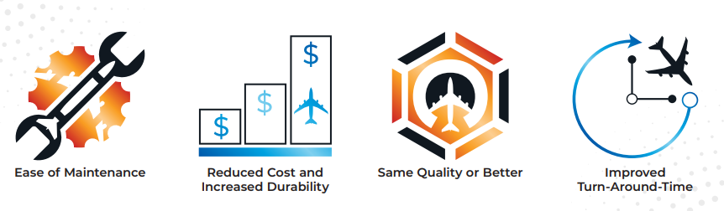
PMA Solutions – What is the Advantage?
At FCAH Aerospace, we are committed to providing innovative solutions that can help support your business objectives. Our PMA solutions are designed to help your organization reduce costs, increase durability, and improve turn-around time. We have Girt Assembly, Cylinders, and Portable Studs that support various fleets that are available for purchase today. Additionally, we are the exclusive distributor of PMA roller systems for cargo aircraft through First Class Air Support.

Slide 5
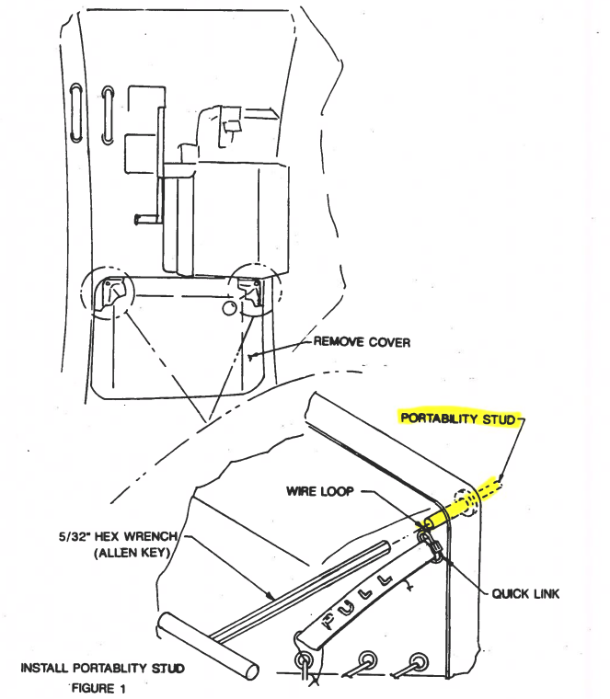
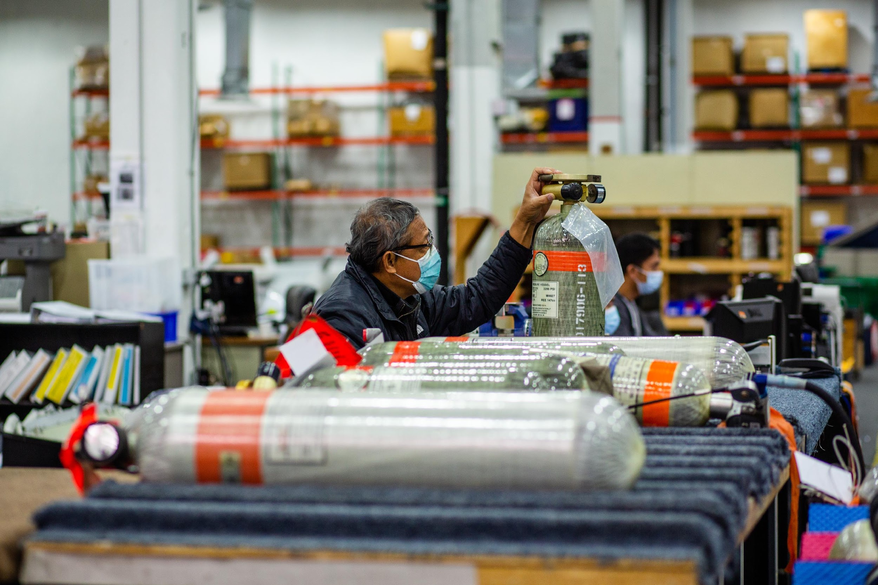
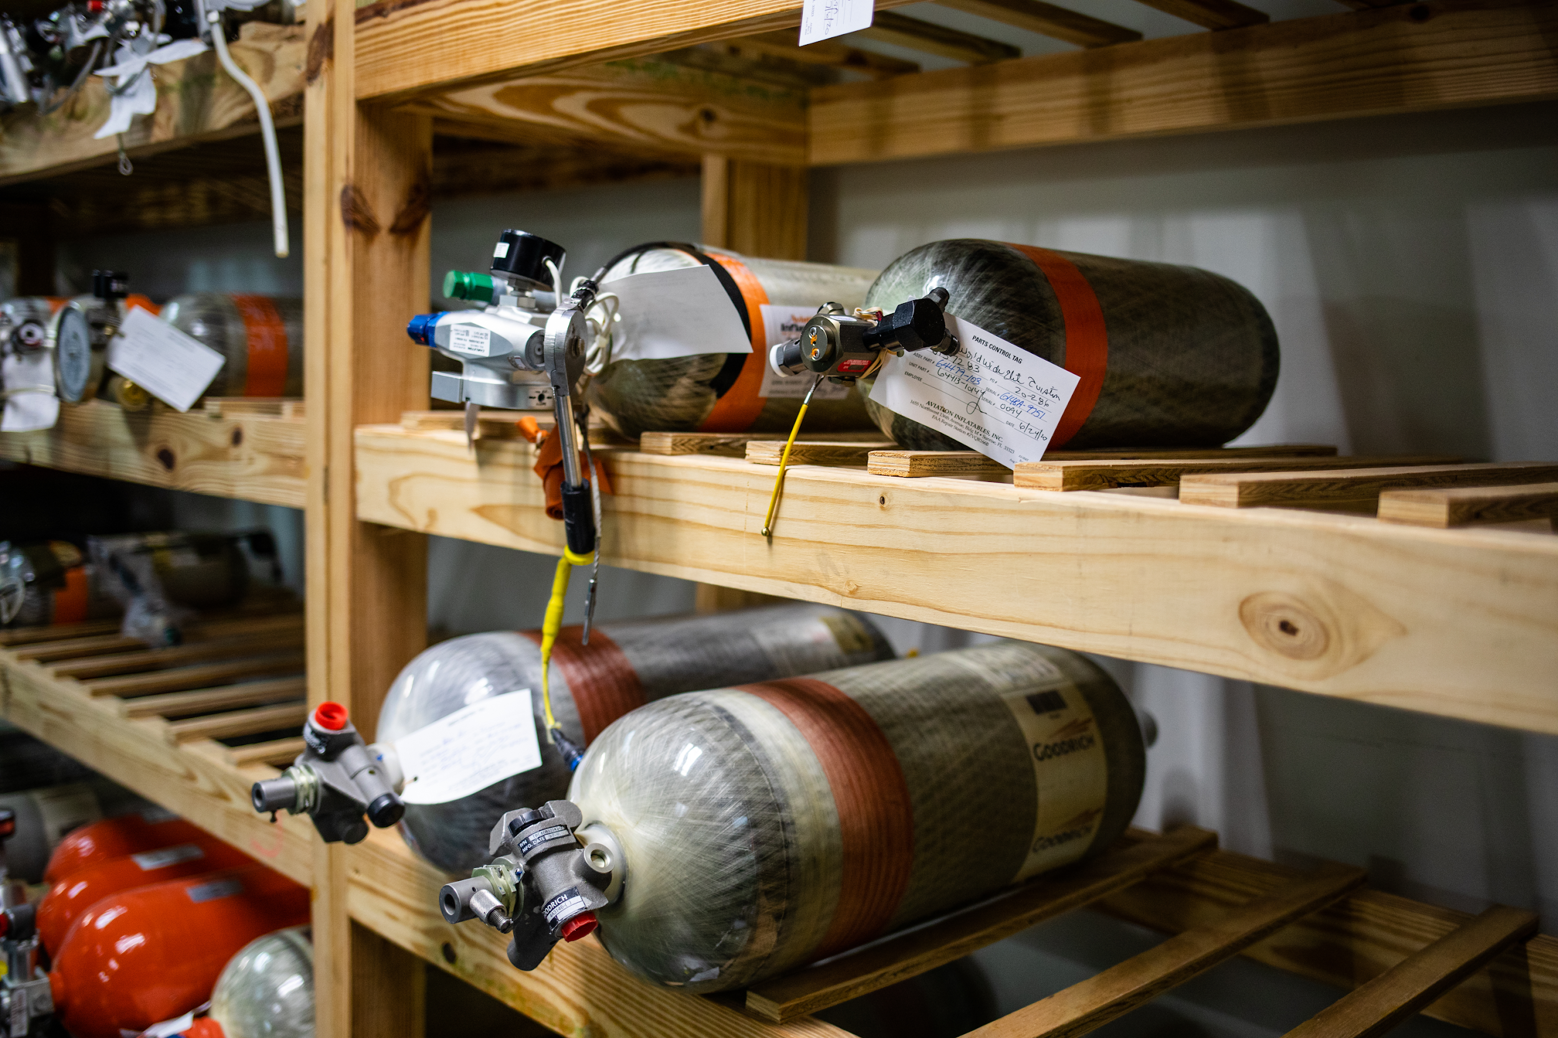
AVI Aviation’s PMA Parts
AVI Aviation offers PMA cylinders, reservoirs, and portability studs.
With these PMA Solutions, you can expect:
Reduced lead time with in-stock inventory
The same quality as the OEM alternative
Lower cost in comparison to the OEM part

Slide 6
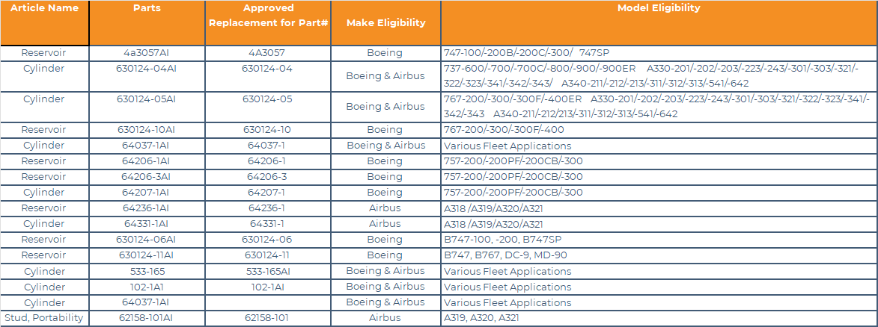
AVI Aviation’s Top Selling PMA Parts

Slide 7
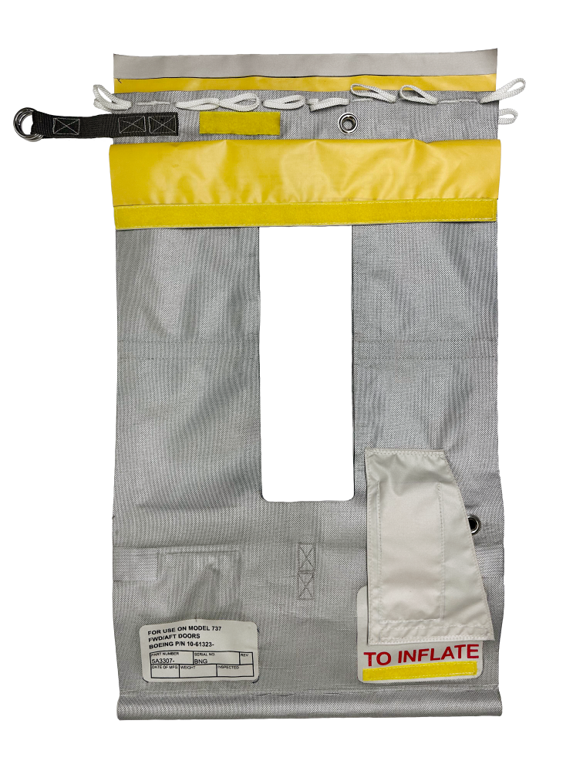
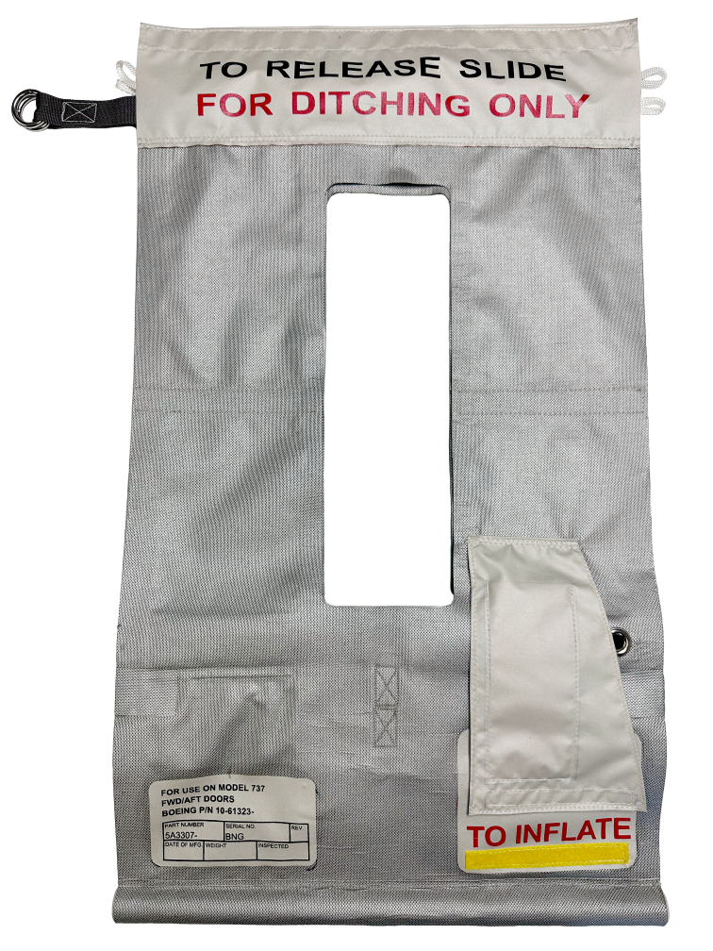
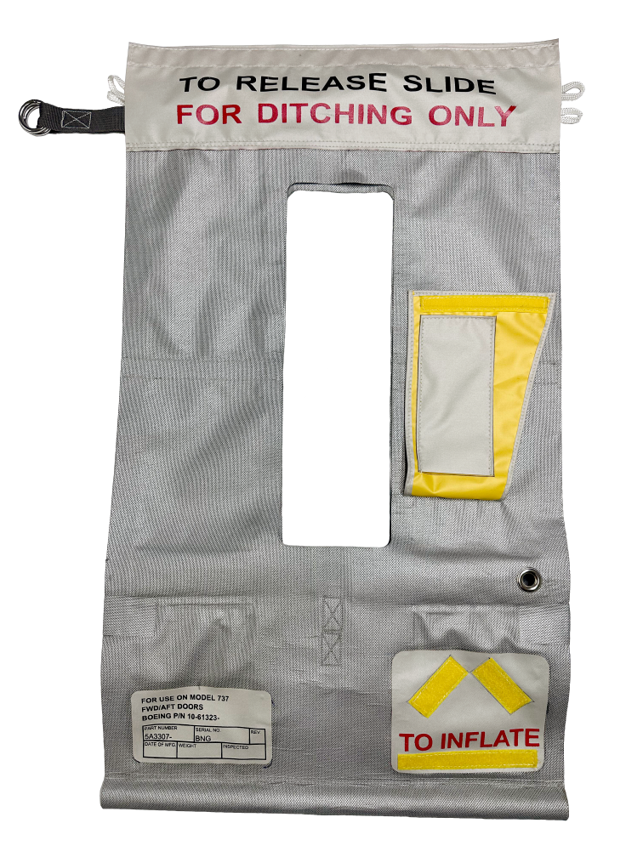
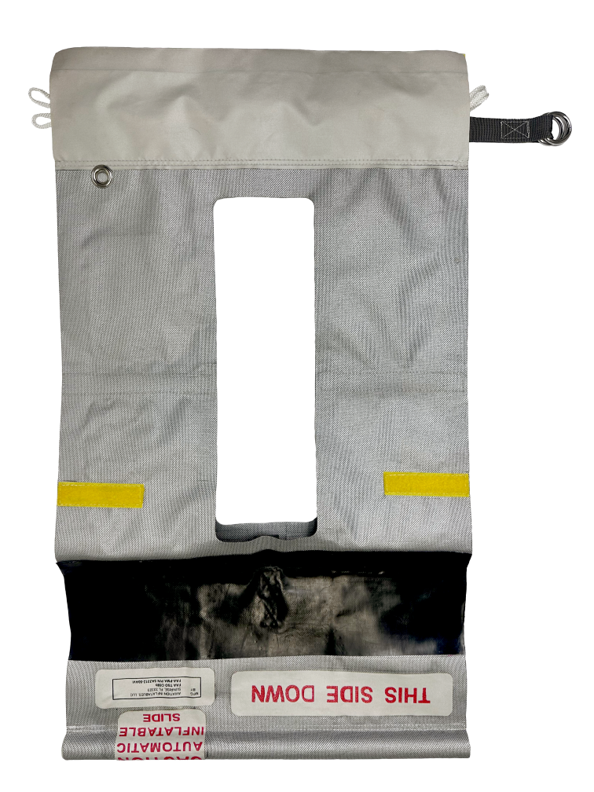
AVI Aviation’s PMA Girt Assembly
AVI Aviation offers PMA Girt Assembly for Boeing 737 5A3307-701 and 5A3307-9.
Features and Functionality:
Constructed of a high-strength, urethane-coated nylon fabric with an aluminized coating to protect against radiated heat. It is a crucial component of the emergency evacuation slide for passenger and crew evacuation.
Connects the slide to the aircraft door and automatically deploys when opened during an emergency.
Inflate after the pack ejects, ensuring a safe and efficient evacuation process.

Slide 8
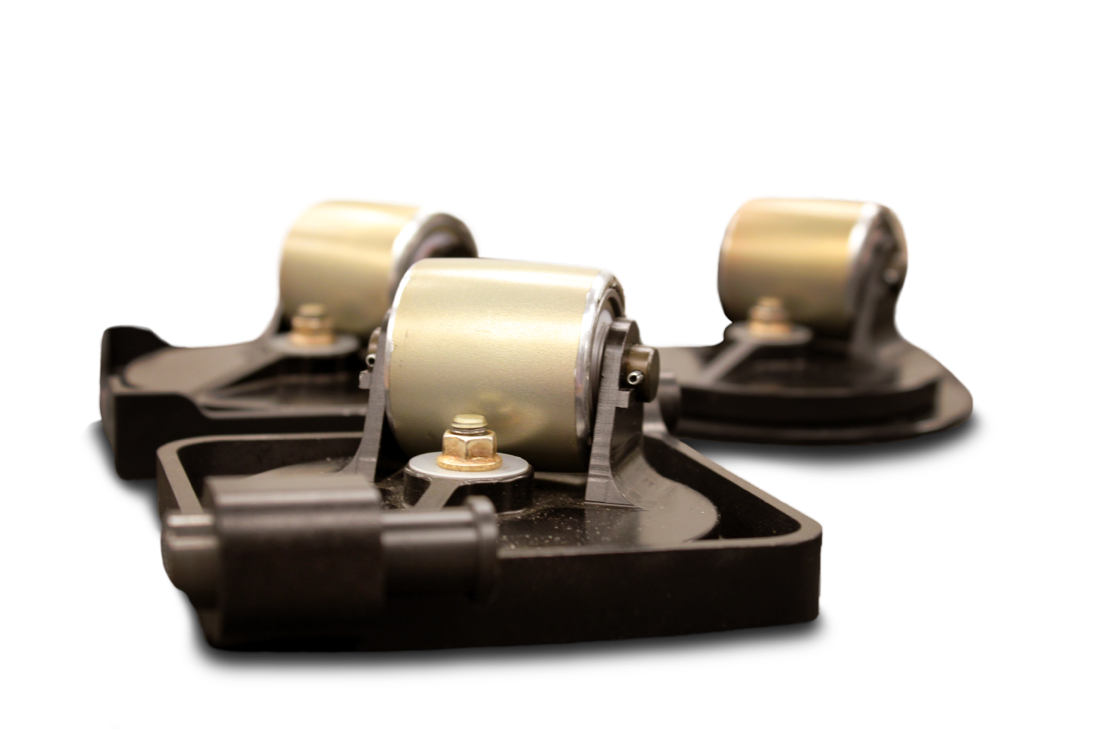
First Class Air Support Roller Systems
First Class Air Support is the exclusive distributor of PMA Roller Systems, offering reduced cost, lower lead time, and available inventory.
Our PMA Roller Systems:
Decrease the number of repairs needed from 6 months to a year with our PMA Roller System
Decreased amount of wear and tear on Unicasters due to dirt and grease
And increased effectiveness by using polymer over the aluminum used for the OEM alternative

Slide 9
Thank You!
Questions?

